Slide 1
Quiz 2 revised

Slide 2
ECDTM ECAER AUOOL EDSAM MERNE NASSO DYTNR VBNLC RLTIQ
LAETR IGAWE BAAEI HOR
9

Slide 3
The transposition cipher quite different in substitution It does not change the identities of the letter but rearrange their position.
The encipher procedure like this.
6 3 2 4 1 5
W E A R E D
I S C O V E
R E D F L E
E A T O N C
E Q K J E U
EVLNE ACDTK ESEAQ ROFOJ DEECU WIREE

Slide 4
How to determine the dimension of the rectangle?
ECDTM ECAER AUOOL EDSAM MERNE NASSO DYTNR VBNLC RLTIQ
LAETR IGAWE BAAEI HOR
9

Slide 5
How to determine the dimension of the rectangle?
In this case we have 63 letters.
Vowel Frequencies can help us to determine the dimensions of the rectangle.
In English approximately 40% of plaintext consists of vowels. Therefore, for the correct dimension, each row of the rectangle should be approximately 40% vowels.
For example, there are 21 letters in the ciphertext.
Because we know that the message completely fills the rectangle, this suggests either a 3X7 or a 7X3 array.
Consider our choice between 3X7 and 7X3 as an example.
For a 3X7 rectangle, each row should contain approximately 2.8 vowels.
Let us note the difference between this estimate and the actual count.

Slide 6
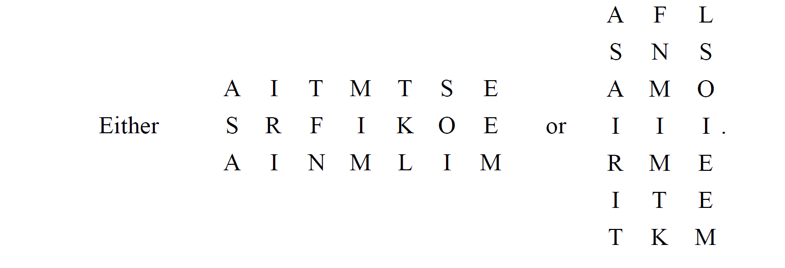

Slide 7
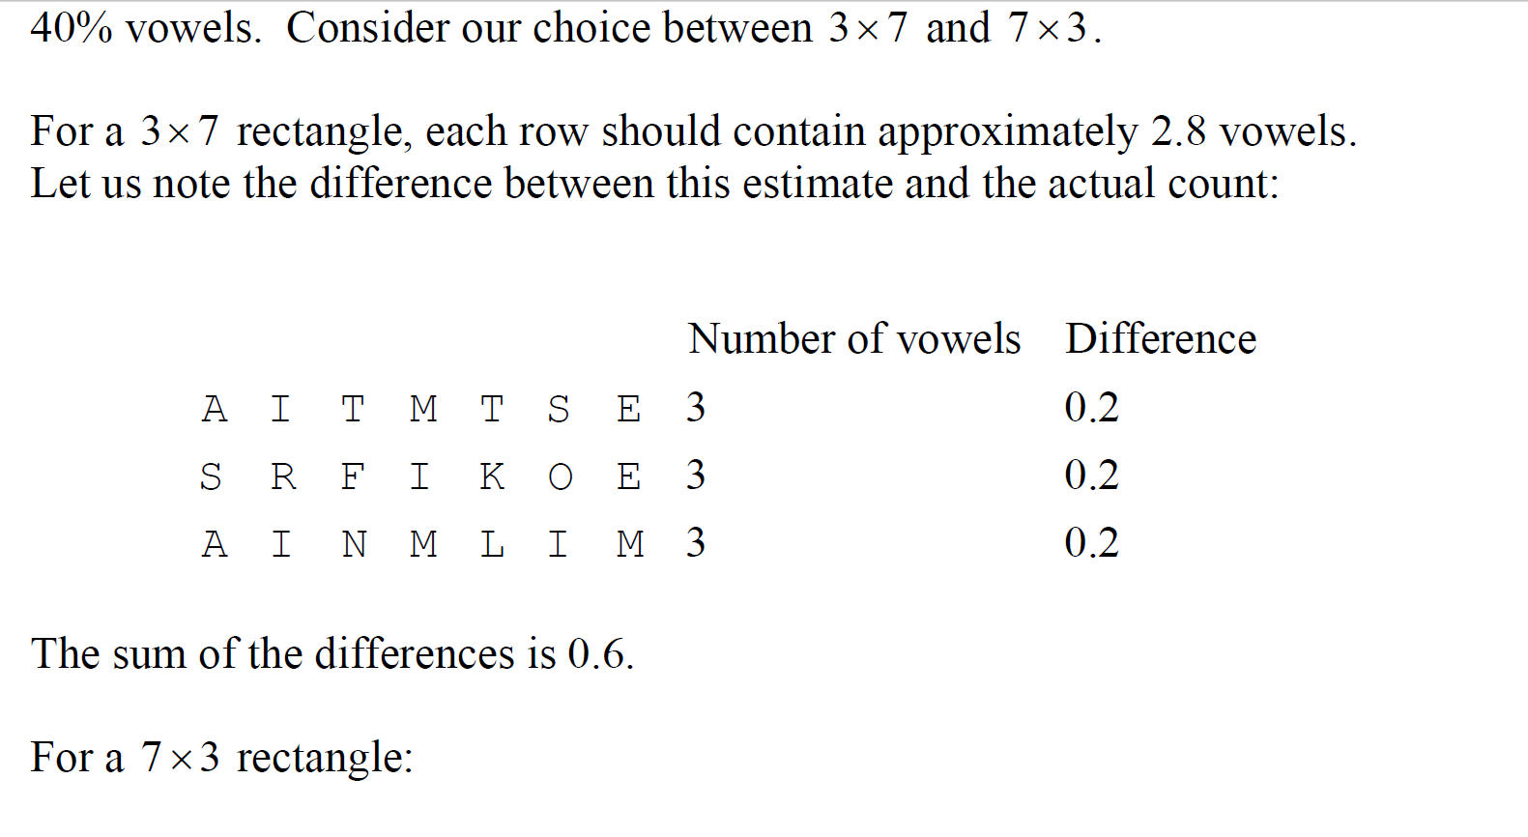

Slide 8
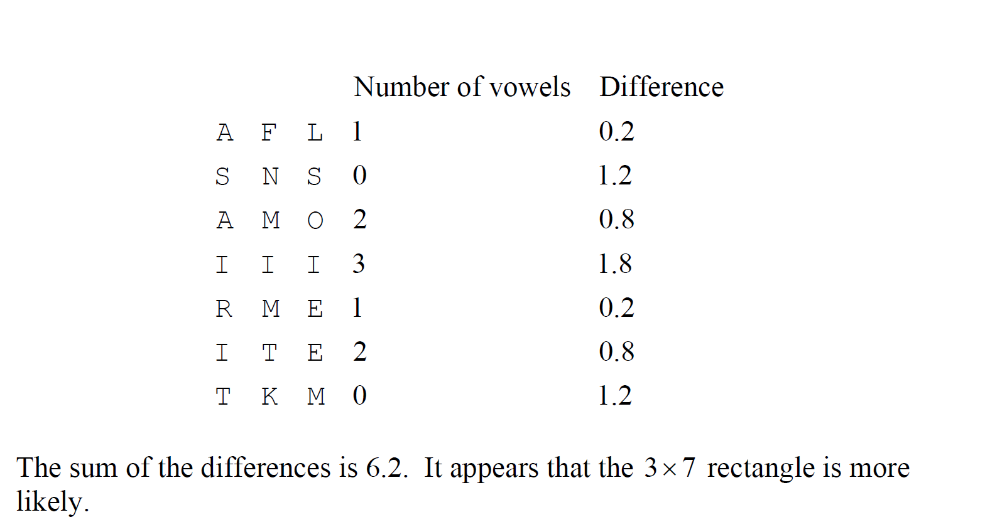

Slide 9
1.Please write a program to determine the dimension of the rectangle for this encryption transposition cipher.
ECDTM ECAER AUOOL EDSAM MERNE NASSO DYTNR VBNLC RLTIQ
LAETR IGAWE BAAEI HOR
9

Slide 10
2. Please Break the following transposition cipher which involves a completely filled rectangles with our HINT.
E R A S B L E
C A M S N A B
D U M O L E A
T O E D C T A
M O R Y R R E
E L N T L I I
C E E N T G H
A D N R I A O
E S A V Q W R
ECDTM ECAER AUOOL EDSAM MERNE NASSO DYTNR VBNLC RLTIQ
LAETR IGAWE BAAEI HOR
9
We assume that this encrypted message is using completely filled rectangle with 9 rows and 7 columns.
9

Slide 11
Please Break the following transposition cipher which involves a completely filled rectangles from next HINT. (CONT)
L | A | S
A | M | S
E | M | O
T | E | D
R | R | Y
I | N | T
G | E | N
A | N | R
W | A | V
Decrypted partially
9

Slide 12
3. Please count Index of Coincidence (IC) for each messages. Usually, The I. C. of English is around 0.066

Slide 13

$f_{a,}$ $f_{b,}f_{c,}…………………………..$ $f_{z,}$
$\frac{\left(f_{a}\right)}{\left(N\right)}$ $\frac{\left(f_{a}−1\right)}{\left(N−1\right)}$
$\frac{\left(f_{i}\right)}{\left(N\right)}$ $\frac{\left(f_{i}−1\right)}{\left(N−1\right)}$
Index of Coincidence I.C. = $\frac{\sum_{i=A}^{i=Z}{\left(f_{i}\right)}\left(f_{i}−1\right)}{\left(N\right)\left(N−1\right)}$

Slide 14
message1
Cryptanalysis in recent publications also cryptanalysis refers in the original sense to the study of methods and techniques to obtain information from sealed texts This information can be both the key used and the original text Nowadays, the term cryptanalysis more generally refers to the analysis of cryptographic methods not only for closure with the aim of either breaking them I e abolishing their protective function or or to prove and quantify their security Cryptanalysis is thus the counterpart to cryptography Both are subfields of cryptology

Slide 15
message2
Die Kryptoanalyse in neueren Publikationen auch Kryptanalyse bezeichnet im ursprunglichen Sinne das Studium von Methoden und Techniken um Informationen aus verschlusselten Texten zu gewinnen Diese Informationen konnen sowohl der verwendete SchlUssel als auch der Originaltext sein Heutzutage bezeichnet der Begriff Kryptoanalyse allgemeiner die Analyse von kryptographischen Verfahren nicht nur zur Verschlusselung mit dem Ziel diese entweder zu brechen d h ihre Schutzfunktion aufzuheben bzw zu umgehen oder ihre Sicherheit nachzuweisen und zu quantifizieren Kryptoanalyse ist damit das Gegenstuck zur Kryptographie Beide sind Teilgebiete der Kryptologie

Slide 16
Message 3
Mvwzxyxejiwgc ml biaorr zyzvmakxgyrq kpqy gpitrkryvcqsw pojcbw gx xfo spskgxej cilci ry xfo wrehw yj koxfyhq krb diarrgaycc xm yfrkml srdyvkkxgyr dbsk ciyvib divdw Rrmq srdyvkkxgyr akr zo fmdl rri ioc scib krb dlc yvgqmlkp robr Xsukhyiw, rri rovk mvwzxyxejiwgc qmbi eorcbejvc pojcbw ry xfo elkpwcmq yj abcndsebenrma wirrsbc rmd slvc dyv avsqevc gmrr xfo egw sd omrrip lvckogxk rrik S i ylsjswfsre dlcsv nbsrogrszc pylmxgyr mb sp ds nbsto eln uskrrsjw dlcsv qogsbmri Gpitrkryvcqsw gc xfew rri ayyldipzepd xm mvwzxmqvyzlw Lsrr epo wsljgopbc sd mvwzxmvsei

Slide 17
Message 4
Fubswdqdobvlv lq uhfhqw sxeolfdwlrqv dovr fubswdqdobvlv uhihuv lq wkh ruljlqdo vhqvh wr wkh vwxgb ri phwkrgv dqg whfkqltxhv wr rewdlq lqirupdwlrq iurp vhdohg whawv Wklv lqirupdwlrq fdq eh erwk wkh nhb xvhg dqg wkh ruljlqdo whaw Qrzdgdbv, wkh whup fubswdqdobvlv pruh jhqhudoob uhihuv wr wkh dqdobvlv ri fubswrjudsklf phwkrgv qrw rqob iru forvxuh zlwk wkh dlp ri hlwkhu euhdnlqj wkhp L h derolvklqj wkhlu surwhfwlyh ixqfwlrq ru ru wr suryh dqg txdqwlib wkhlu vhfxulwb Fubswdqdobvlv lv wkxv wkh frxqwhusduw wr fubswrjudskb Erwk duh vxeilhogv ri fubswrorjb

Slide 18
4. Given the following ciphertext, please determine if this encrypted message was enciphered using a monoalphabetic or polyalphabetic cipher based on the message’s index of coincidence (I.C).

Slide 19
RHVST TEYSJ KMHUM BBCLC GLKBM HBSJH HDAYC PPWHD UUTAP STJAI YMXKA OKARN NATNG CVRCH BNGJU EMXWH UERZE RLDMX MASRT LAHRJ KIILJ BQCTI BVFZW TKBQE OPKEQ OEBMU NUTAK ZOSLD MKXVO YELLX SGHTT PNROY MORRW BWZKX FFIQJ HVDZZ JGJZY IGYAT KWVIB VDBRM BNVFC MAXAM CALZE AYAZK HAOAA ETSGZ AAJFX HUEKZ IAKPM FWXTO EBUGN THMYH FCEKY VRGZA QWAXB RSMSI IWHQM HXRNR XMOEU ALYHN ACLHF AYDPP JBAHV MXPNF LNWQB WUGOU LGFMO BJGJB PEYVR GZAQW ANZCL XZSVF BISMB KUOTZ TUWUO WHFIC EBAHR JPCWG CVVEO LSSGN EFGCC SWHYK BJHMF ONHUE BYDRS NVFMR JRCHB NGJUB TYRUU TYVRG ZAXWX CSADX YIAKL INGXF FEEST UWIAJ EESFT HAHRT WZGTM CRS

